Slide 1
Tree
Abu Saleh Musa Miah

Slide 2
Discussed So far
Here are some of the data structures we have studied so far:
Arrays
Stacks, Queues and deques
Linked list
Inherently uni-dimensional in structure

Slide 3
Tree
A tree is defined as a finite set of one or more nodes such that
[a] There is a specially designated node called the root and
[b] The rest of the nodes could be partitioned into t disjoint sets (t >0) each set representing a tree T_{i}, i=1,2, . . . t known as subtree of the tree.

Slide 4
Tree
A node in the definition of the tree represents an item of information, and the links between the nodes termed as branches, represent an association between the items of information.

Slide 5
A
Level 1
B
C
D
E
Level 2
F
G
H
I
J
K
Level 3
L
Level 4

Slide 6
Tree
Definition of Tree emphasizes on the aspect of
[a] Connectedness, and
[b] Absence of closed loops

Slide 7
Basic terminologies
degree of the node
leaf nodes or terminal nodes
non terminal nodes
children
siblings
ancestors
degree of a tree
hierarchical structure
height or depth of a tree
forest

Slide 8
Tree Terminology
A tree consists of a collection of elements or nodes, with each node linked to its successors
The node at the top of a tree is called its root
The links from a node to its successors are called branches
The successors of a node are called its children

Slide 9
Tree Terminology (continued)
Each node in a tree has exactly one parent except for the root node, which has no parent
Nodes that have the same parent are siblings
A node that has no children is called a leaf node
A generalization of the parent-child relationship is the ancestor-descendent relationship

Slide 10
Tree Terminology (continued)
The predecessor of a node is called its parent
A subtree of a node is a tree whose root is a child of that node
The level of a node is a measure of its distance from the root

Slide 11
Tree Terminology (continued)
Node: stores the actual data and links to other nodes
Parent: immediate predecessor of a node
Root: specially designated node which has no parent
Child:immediate successor of a node.

Slide 12
Tree Terminology(continued)
Leaf: node without any child
Level: rank of the hierarchy and root node has level zero(0). Node at level i has the level i+1 for its child and i-1 for its parent. This is true for all nodes except the root

Slide 13
Tree Terminology (continued)
Height (depth): Maximum number of nodes possible in a path starting from root node to leaf node. Height of a tree given by h = l_{max}, l_{max} is the maximum level of the tree.
Degree of node→ maximum number of children possible for a node
Siblings → nodes having the same parent

Slide 14
Tree Terminology
Ancestor of a Node: Those nodes that occur on the path from the root to the given node
Degree of a Tree: Maximum degree of the node in the tree
Forest : A set of Zero or more Disjoint trees.

Slide 15
Degree of the tree = 4 ( Max degree of A)
A
Level 1
B
C
D
E
Level 2
F
G
H
I
J
K
Level 3
Height of the tree = 4 (Max level)
L
Level 4

Slide 16
Representation of a tree
List Representation
(A (B(F,G,H), C, D(I), E(J,K(L))) ) for the tree Considered in the Example
Linked List Representation

Slide 17
DATA
LINK 1
LINK 2
…
LINK n
(a) General node structure
T
A
B
C
D
E
F
G
H
I
J
K
L
(b) Linked list representation of the tree

Slide 18
An alternative elegant linked representation
TAG DATA / DOWNLINK
LINK
1/0
(a) General node structure

Slide 19
An alternative elegant linked representation
1
A
0
1
C
0
0
1
B
1
F
1
G
1
H
1
D
1
I
1
E
1
J
O
1
K
1
L
(b) Linked representation of the tree

Slide 20
Binary Trees
A binary tree T is defined as a finite set of elements called nodes such that
[a] T is empty (Called the Null tree or Empty tree) or
[b] T contains a distinguished node R called the root of T and the remaining nodes of T form an ordered pair of disjoint binary trees T₁ and T₂

Slide 21
Binary Trees
A binary tree has the characteristic of all nodes having at most two branches, that is, all nodes have a degree of at most 2.
A binary tree can therefore be empty or consist of a root node and two disjoint binary trees termed left subtree and right subtree.

Slide 22
A
Level 1
B
C
Level 2
D
E
F
G
Level 3

Slide 23
Important observations regarding binary trees:
The maximum number of nodes on level i of a binary tree is 2^{i-1}, i>1
The maximum number of nodes in a binary tree of height h is 2^{h}-1, h>1
For any non empty binary tree, if t_{o} is the number of terminal nodes and t₂ is the number of nodes of degree 2, then t_{o}=t₂+1

Slide 24
A binary tree of height h which has all its permissible maximum number of nodes viz., 2^{h}-1 intact is known as a full binary tree of height h.
1
A
2
B
C
3
D
E
6
F
G
4
5
7

Slide 25
A binary tree with n’ nodes and height h is complete if its nodes correspond to the nodes which are numbered 1 to n (n’≤ n) in a full binary tree of height h.
Height of a complete binary tree with n given by
A
1
B
C
3
2
4
D
E
F
5
6

Slide 26
A complete binary tree obeys the following properties with regard to its node numbering:
[a] If a parent node has a number i then its left child has the number 2i (2i < n). If 2i > n then i has no left child.
[b] If a parent node has a number i, then its right child has the number 2i+1 (2i + 1 <n). If 2i + 1 > n then i has no right child.

Slide 27
A complete binary tree obeys the following properties with regard to its node numbering:
[c] If a child node (left or right) has a number i then the parent node has the number ⎣i /2⎦ if i ≠1. If i =1 then i is the root and hence has no parent.

Slide 28
A binary tree which is dominated solely by left child nodes or right child nodes is called a skewed binary tree or more specifically left skewed binary tree or right skewed binary tree respectively.
a
m
b
n
c
o
d
Left skewed
Right skewed
p

Slide 29
Extended Binary Tree: 2-Tree
A binary tree T is said to be 2-Tree or an extended binary tree if each node N has either 0 or 2 children.
Nodes with 2 children are called internal nodes and the nodes with 0 children are called external nodes.

Slide 30
Representation of Binary Tree
Binary tree can be represented by means of
[a] Array
[b] linked list

Slide 31
Representation Of Binary Trees
Array Representation
1
Sequential representation of a tree with depth d will require an array with approx 2^{d + 1} elements
a
2
b
4
5
c
d
10
e
f
11
1 | 2 | 3 | 4 | 5 | 6 | 7 | 8 | 9 | 10 | 11
a | b |  | c | d |  |  |  |  | e | f

Slide 32
Linked representation
T
LCHILD
DATA
RCHILD
a
b
c
d
e
f

Slide 33
Observation regarding the linked representation of Binary Tree
[a] If a binary tree has n nodes then the number of pointers used in its linked representation is 2 * n
[b] The number of null pointers used in the linked representation of a binary tree with n nodes is n + 1

Slide 34
Traversing Binary Tree
Three ways of traversing the binary tree T with root R
Preorder
[a] Process the root R
[b] Traverse the left sub-tree of R in preorder
[c] Traverse the right sub-tree of R in preorder
a. k. a node-left-right traversal (NLR)

Slide 35
Traversing Binary Tree
In-order
[a] Traverse the left sub-tree of R in in-order
[b] Process the root R
[c] Traverse the right sub-tree of R in in-order
a. k. a left-node-right traversal (LNR)

Slide 36
Traversing Binary Tree
Post-order
[a] Traverse the left sub-tree of R in post-order
[b] Traverse the right sub-tree of R in post-order
[c] Process the root R
a. k. a left-right-node traversal (LRN)

Slide 37
Illustrations for Traversals
Assume: visiting a node
is printing its label
Preorder:
1 3 5 4 6 7 8 9 10 11 12
Inorder:
4 5 6 3 1 8 7 9 11 10 12
Postorder:
4 6 5 3 8 11 12 10 9 7 1
1
3
7
5
8
9
10
4
6
11
12

Slide 38
Illustrations for Traversals (Contd.)
Assume: visiting a node
is printing its data
Preorder: 15 8 2 6 3 7
11 10 12 14 20 27 22 30
Inorder: 2 3 6 7 8 10 11
12 14 15 20 22 27 30
Postorder: 3 7 6 2 10 14
12 11 8 22 30 27 20 15
15
8
20
2
11
27
6
10
12
22
30
3
7
14

Slide 39
Formulation of Binary tree from Its traversal
1. If preorder is given=>First node is the root
If postorder is given=>Last node is the root
2. Once the root node is identified ,all nodes in the left subtrees and right subtrees of the root node can be identified.
3. Same technique can be applied repeatedly to form subtrees

Slide 40
4.Two traversals are essential out of which one should inorder, another may be preorder or postorder
5. But we can’t form a binary tree if only preorder and postorder has given.

Slide 41
Example: For Given Inorder and Preorder
Inorder: D B H E A I F J F CG
Preorder: A B D E H C F I J G
Now root is A
Left subtree: D B H E
Right subtree: I F J C G

Slide 42
continues.
A
In:D B H E I F J C G
Pre:B D E H C F I J G
D H E I F J G
E H F I J
I J
H

Slide 43
Example: For Given Inorder and Postorder
Inorder: n1,n2, n3, n4, n5, n6, n7, n8, n9
Postorder: n1,n3, n5, n4, n2, n8, n7, n9, n6
So here n6 is the root

Slide 44
n6
In:n1,n2,n3,n4,n5
n7,n8,n9
Post:n1,n3,n5,n4,n2
n8,n7,n9
n1
n3,n4,n5
n7,n8
n3,n5,n4
n8,n7
n3
n5
n8

Slide 45
Traversal Algorithm Using Stack
Assumption
Binary Tree is represented by
TREE(INFO, LEFT, RIGHT, ROOT)
A variable PTR (pointer) will contain the location of the node N currently being scanned. An array STACK will hold the addresses of the node for future processing

Slide 46
Pre-Order Traversal
[1] [ Initially push NULL onto STACK and initialize PTR]
Set TOP =1, STACK[1] = NULL and PTR = ROOT
[2] Repeat Steps 3 to 5 while PTR ≠ NULL
[3] Apply PROCESS to PTR->INFO

Slide 47
Pre-Order Traversal
[4] [Right Child ?]
If PTR -> RIGHT ≠ NULL, then [Push on STACK]
SET TOP = TOP + 1
STACK[TOP] = PTR->RIGHT
[5] [Left Child ?]
If PTR->LEFT ≠ NULL, Then
Set PTR = PTR->LEFT
Else
Set PTR = STACK[TOP],
TOP = TOP-1
[6] Exit

Slide 48
Pre-Order Traversal
A
B C
D E F
G H
K

Slide 49
[1] Initially push NULL onto STACK
STACK = φ
Set PTR = A , the root of T
[2] Proceed down the left-most path rooted at PTR = A as follows
(i) Process A and Push its right child C onto STACK:
STACK: φ, C
(ii) Process B. (There is no Right Child)
(iii) Process D and push its Right Child H onto STACK. STACK: φ, C, H
(iv) Process G (There is no right child)

Slide 50
[3] [Backtracking] Pop the top element H from STACK, and set PTR = H
STACK: φ, C
[4] Proceed down the left-most path rooted at PTR = H as follows
(v) Process H and Push its right child K onto STACK:
STACK: φ, C, K
[No other node is processed, since H has no left child]
[5] [Backtracking] Pop the top element K from STACK, and set PTR = K
STACK: φ, C

Slide 51
[6] Proceed down the left-most path rooted at PTR = K as follows
(vi) Process K. (There is no right child)
[No other node is processed, since K has no left child]
[7] [Backtracking] Pop the top element C from STACK, and set PTR = C
STACK: φ
[8] Proceed down the left-most path rooted at PTR = C as follows
(vii) Process C and push its right child F onto STACK.
STACK: φ, F
(viii) Process E (There is no right child)

Slide 52
[9] [Backtracking] Pop the top element F from STACK, and set PTR = F
STACK: φ
[10] Proceed down the left-most path rooted at PTR = F as follows
(ix) Process F. (There is no right child)
[No other node is processed, since F has no left child]
[11] [Backtracking] Pop the top element NULL from STACK, and set PTR = NULL

Slide 53
In-order Traversal
[1] [Push NULL onto STACK and initialize PTR]
Set TOP =1, STACK[1] = NULL, PTR = ROOT
[2] Repeat while PTR ≠ NULL [Pushes the Left-most path onto STACK]
(a) Set TOP = TOP + 1, STACK[TOP] = PTR
(b) Set PTR = PTR -> LEFT
[3] Set PTR = STACK[TOP], TOP = TOP -1
[Pops node from STACK]

Slide 54
In-order Traversal
[4] Repeat Steps 5 to 7 while PTR ≠ NULL: [Backtracking]
[5] Apply PROCESS to PTR->INFO
[6] [Right Child ?] If PTR->RIGHT ≠ NULL then
(a) Set PTR = PTR->RIGHT
(b) Go to Step 2
[7] Set PTR = STACK[TOP], TOP = TOP -1
[8] Exit

Slide 55
In-Order Traversal
A
B C
D E
G H
K L M

Slide 56
[1] Initially Push NULL onto STACK
STACK = φ
Set PTR = A , the root of T
[2] Proceed down the left-most path rooted at PTR = A, pushing the nodes A, B, D, G and K onto STACK:
STACK = φ, A, B, D, G, K
[3] [Backtracking] The nodes K, G and D are popped and processed
STACK = φ, A, B
Set PTR = H [Right Child of D]
[4] Proceed down the left-most path rooted at PTR = H, pushing the nodes H and L onto STACK:
STACK = φ, A, B, H, L

Slide 57
[5] [Backtracking] Nodes L and H are popped and processed
STACK = φ, A, B
Set PTR = M, the Right child of H
[6] Proceed down the left-most path rooted at PTR = M, pushing node M onto STACK
STACK = φ, A, B, M
[7] [Backtracking] Nodes M, B and A are popped and processed
STACK = φ
Set PTR = C, the Right child of A

Slide 58
[8] Proceed down the left-most path rooted at PTR = C, pushing node C and E onto STACK
STACK = φ, C, E
[9] [Backtracking] Nodes E and C are popped and processed.

Slide 59
[8] Proceed down the left-most path rooted at PTR = C, pushing node C and E onto STACK
STACK = φ, C, E
[9] [Backtracking] Nodes E and C are popped and processed.

Slide 60
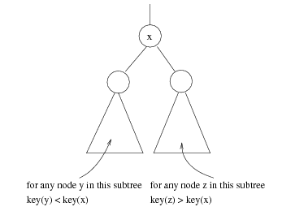
x
For any node z in this subtree key(z) > key(x)
For any node y in this subtree key(y) < key(x)

Slide 61
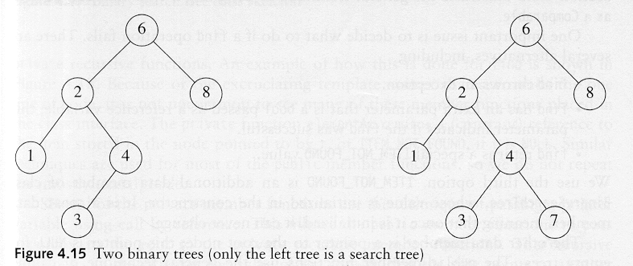
Binary Search Trees
A binary search tree
Not a binary search tree

Slide 62
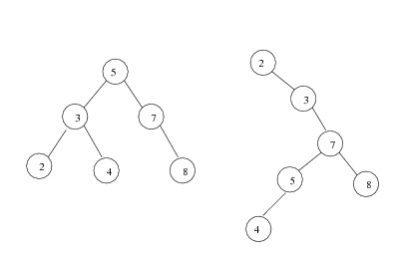
Binary search trees
Two binary search trees representing the same set:
Average depth of a node is O(log N); maximum depth of a node is O(N)

Slide 63
Searching and Inserting in BST
Algorithm to find the location of ITEM in the BST T or insert ITEM as a new node in its appropriate place in the tree
[a] Compare ITEM with the root node N of the tree
(i) If ITEM < N, proceed to the left child of N
(ii) If ITEM > N, proceed to the right child of N

Slide 64
Searching and Inserting in BST
Algorithm to find the location of ITEM in the BST T or insert ITEM as a new node in its appropriate place in the tree
[b] Repeat Step (a) until one of the following occurs
(i) We meet a node N such that ITEM = N. In this case search is successful
(ii) We meet an empty sub-tree, which indicates that search is unsuccessful and we insert ITEM in place of empty subtree

Slide 65
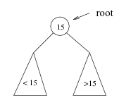
Searching BST
If we are searching for 15, then we are done.
If we are searching for a key < 15, then we should search in the left subtree.
If we are searching for a key > 15, then we should search in the right subtree.

Slide 66
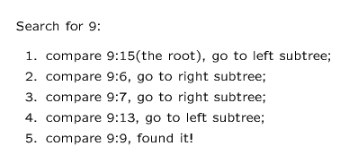
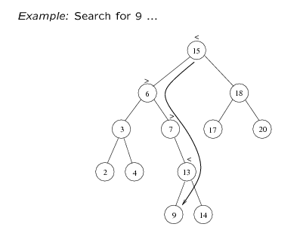

Slide 67
Insert 40, 60, 50, 33, 55, 11 into an empty BST
40
40
40
40
60
60
60
33
1. ITEM = 40
50
50
2. ITEM = 60
3. ITEM = 50
4. ITEM = 33

Slide 68
Insert 40, 60, 50, 33, 55, 11 into an empty BST
40
40
60
33
60
33
50
11
50
55
55
5. ITEM = 55
6. ITEM = 11

Slide 69
Locating an ITEM
A binary search tree T is in memory and an ITEM of information is given. This procedure finds the location LOC of ITEM in T and also the location of the parent PAR of ITEM.

Slide 70
Locating an ITEM
Three special cases:
[1] LOC == NULL and PAR == NULL, tree is empty
[2] LOC ≠ and PAR == NULL, ITEM is the root of T
[3] LOC == NULL and PAR ≠ NULL, ITEM is not in T and can be added to T as child of the node N with location PAR.

Slide 71
FIND(INFO,LEFT,RIGHT,ROOT,ITEM,LOC,PAR)
[1] [Tree empty ?]
If ROOT == NULL, then
Set LOC = NULL, PAR = NULL, Exit
[2] [ITEM at root ?]
If ROOT->INFO == ITEM, then
Set LOC = ROOT, PAR = NULL, Exit
[3] [Initialize pointer PTR and SAVE]
If ITEM < ROOT->INFO then
Set PTR = ROOT->LEFT, SAVE = ROOT
Else
Set PTR = ROOT->RIGHT, SAVE =ROOT

Slide 72
[4] Repeat Step 5 and 6 while PTR ≠ NULL
[5] [ITEM Found ?]
If ITEM == PTR->INFO, then
Set LOC = PTR, PAR = SAVE, Exit
[6] If ITEM < PTR->INFO, then
Set SAVE = PTR, PTR = PTR->LEFT
Else
Set SAVE = PTR, PTR = PTR->RIGHT
[7] [Search Unsuccessful]
Set LOC = NULL, PAR = SAVE
[8] Exit

Slide 73
A binary search Tree T is in memory and an ITEM of information is given. Algorithm to find the location LOC of ITEM in T or adds ITEM as a new node in T at location LOC.

Slide 74
[1] Call FIND(INFO, LEFT,RIGHT,ROOT,ITEM,LOC,PAR)
[2] If LOC ≠ NULL, then Exit
[3] [Copy the ITEM into the node NEW]
(a) Create a node NEW
(b) NEW->INFO = ITEM
( c) Set LOC = NEW, NEW->LEFT = NULL, NEW->RIGHT = NULL

Slide 75
[4] [Add ITEM to tree]
If PAR = NULL
Set ROOT = NEW
Else
If ITEM < PAR->INFO, then
Set PAR->LEFT = NEW
Else
Set PAR->RIGHT = NEW
[5] Exit

Slide 76
Binary Search Tree
Insert Algorithm
If value we want to insert < key of current node, we have to go to the left subtree
Otherwise we have to go to the right subtree
If the current node is empty (not existing) create a node with the value we are inserting and place it here.

Slide 77
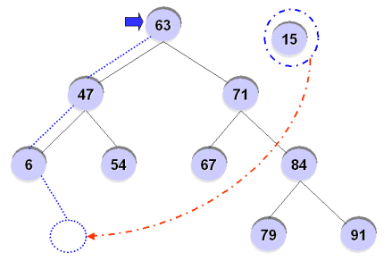
Binary Search Tree
For example, inserting ’15’ into the BST?

Slide 78
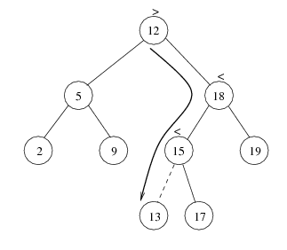

Slide 79
Deletion from BST
T is a binary tree. Delete an ITEM from the tree T
Deleting a node N from tree depends primarily on the number of children of node N

Slide 80
Deletion
There are three cases in deletion
Case 1. N has no children. N is deleted from the T by replacing the location of N in the parent node of N by null pointer
40
33
60
11
50
55
ITEM = 11

Slide 81
Deletion
Case 2. N has exactly one children. N is deleted from the T by simply replacing the location of N in the parent node of N by the location of the only child of N
40
33
60
11
50
55
ITEM = 50

Slide 82
Deletion
Case 2.
40
33
60
11
55
ITEM = 50

Slide 83
Deletion
Case 3. N has two children. Let S(N) denote the in-order successor of N. Then N is deleted from the T by first deleting S(N) from T and then replacing node N in T by the node S(N)
40
33
60
11
50
55
ITEM = 40

Slide 84
Deletion
Case 3.
40
50
33
60
33
60
11
55
11
55
Delete 50
Replace 40 by 50

Slide 85
Types of Binary Trees
Degenerate – only one child
Balanced – mostly two children
Complete – always two children
Degenerate binary tree
Balanced binary tree
Complete binary tree

Slide 86
Binary Trees Properties
Degenerate
Height = O(n) for n nodes
Similar to linear list
Balanced
Height = O( log(n) ) for n nodes
Useful for searches
Degenerate binary tree
Balanced binary tree

Slide 87
Binary Search Trees
Key property
Value at node
Smaller values in left subtree
Larger values in right subtree
Example
X > Y
X < Z
X
Y
Z

Slide 88
Binary Search Trees
Examples
5
10
10
2
45
5
30
5
45
30
2
25
45
2
25
30
10
25
Binary search trees
Non-binary search tree

Slide 89
Example Binary Searches
Find ( 25 )
10
5
10 < 25, right
30 > 25, left
25 = 25, found
5 < 25, right
45 > 25, left
30 > 25, left
10 < 25, right
25 = 25, found
5
30
2
45
2
25
45
30
10
25

Slide 90
Binary Search Properties
Time of search
Proportional to height of tree
Balanced binary tree
O( log(n) ) time
Degenerate tree
O( n ) time
Like searching linked list / unsorted array
Requires
Ability to compare key values

Slide 91
Binary Search Tree Construction
How to build & maintain binary trees?
Insertion
Deletion
Maintain key property (invariant)
Smaller values in left subtree
Larger values in right subtree

Slide 92
Binary Search Tree – Insertion
Algorithm
Perform search for value X
Search will end at node Y (if X not in tree)
If X < Y, insert new leaf X as new left subtree for Y
If X > Y, insert new leaf X as new right subtree for Y
Observations
O( log(n) ) operation for balanced tree
Insertions may unbalance tree

Slide 93
Example Insertion
Insert ( 20 )
10
10 < 20, right
30 > 20, left
25 > 20, left
Insert 20 on left
5
30
2
25
45
20

Slide 94
Binary Search Tree – Deletion
Algorithm
Perform search for value X
If X is a leaf, delete X
Else // must delete internal node
a) Replace with largest value Y on left subtree
OR smallest value Z on right subtree
b) Delete replacement value (Y or Z) from subtree
Observation
O( log(n) ) operation for balanced tree
Deletions may unbalance tree

Slide 95
Example Deletion (Leaf)
Delete ( 25 )
10
10
10 < 25, right
30 > 25, left
25 = 25, delete
5
30
5
30
2
25
45
2
45

